Slide 1
Distribution System State Estimation and Smart Meter Analysis
Instructor: Dr. Zhaoyu Wang
GRA: Dingwei Wang
Department of Electrical and Computer Engineering
Iowa State University

Slide 2
Contents
Introduction to State Estimation (SE)
The concept of SE
Conventional SE method
Introduction to Distribution System State Estimation (DSSE)
Transmission and distribution grids
The concept of DSSE
Conventional DSSE method
DSSE Research Topics
The challenges of DSSE
Observability problem
Metering device placement
Unbalanced problem
Topology configuration
Renewable integration
Robust DSSE methods
Smart meter data analysis
Conclusion
ECE

Slide 3
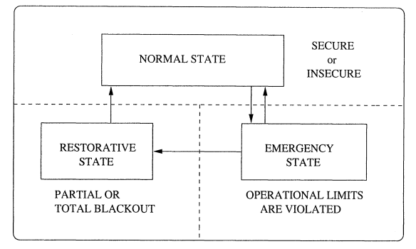
The Concept of SE
What is the state in the power system
In general, power system has normal, emergency, and restorative states.
To monitor system states, different measurements from all parts of the system need to be utilized.
State estimation is a data processing algorithm for converting redundant meter readings into an estimate of the state of an electric power system.
Fig. 1 State Diagram for Power System Operation [1]
[1] Gomez-Exposito A, Abur A. Power system state estimation: theory and implementation[M]. CRC press, 2004.
ECE

Slide 4
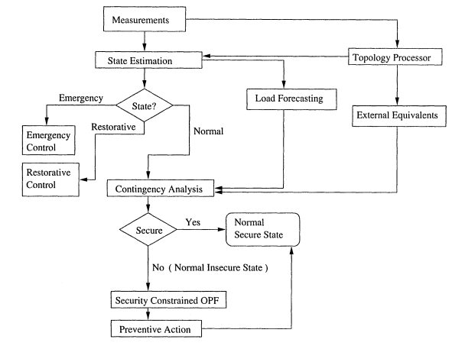
The Concept of SE
SE is a widely-used tool in transmission systems. In the transmission system SE, voltage magnitudes and phase angles are considered the states of systems.
Fig. 2 On-line Static Security Assessment: Functional Diagram [1]
ECE

Slide 5
The Concept of SE
Why is it important to use SE in the power system-
Various constraints make it impossible to have a good picture of the power system [2]:
Because of economical constraints, measurement devices can not be installed everywhere, so the data is incomplete.
Because of the meter malfunction and the communication problem, the measurements are subject to error or loss, so the data is inaccurate, unreliable, and delayed.
[2] H. Wang and N. N. Schulz, “A revised branch current-based distribution system state estimation algorithm and meter placement impact,” IEEE
Trans. Power Syst., vol. 19, no. 1, pp. 207–213, Feb. 2004
ECE

Slide 6
The Concept of SE
Types of Measurement Errors
Random errors – depend on the class of precision of the measurements (phasor measurement unit, smart meter, etc.).
Intermittent errors – large noise or temporary failures due to communication or meter malfunction.
Systematic errors – deterioration of measurements due to age, temperature, weather, and other environmental effects [3].
[3] Zhong, Shan, and Ali Abur, “Combined state estimation and measurement calibration,” IEEE Trans. Power Syst., vol. 20, no. 1, pp. 458–465, Feb., 2005
ECE

Slide 7
Conventional SE Method
Traditionally, bus voltage magnitudes and phase angles have been used as state variables in transmission systems. The basic equation of SE can be written by:
$$z=\left[\begin{matrix}z_{1} \\ ⋮ \\ z_{m}\end{matrix}\right]=\left[\begin{matrix}h_{1}\left(x_{1},…,x_{n}\right) \\ ⋮ \\ h_{m}\left(x_{1},…,x_{n}\right)\end{matrix}\right]+\left[\begin{matrix}e_{1} \\ ⋮ \\ e_{m}\end{matrix}\right]=h\left(x\right)+e$$
Where $x_{n}$ is the state variable of bus n, $z_{m}$ is the m-th real measurements, $h_{m}$ is the nonlinear measurement function to connect x and z, and e is the measurement error.
ECE

Slide 8
Conventional SE Method
The problem can be formulated as a Weighted Least Square (WLS) optimization method [1]:
where $\hat{x}$ is the estimated state vector, $T$ is the matrix transposition operation, and W denotes the weight matrix that represents the user’s confidence in the measured data. A widely-used choice for the weight matrix is $W=diag\left\{σ_{1}^{−2},…,σ_{m}^{−2}\right\}$, where $σ_{j}^{−2}$ represents the variance of the measurement error corresponding to the $j^{th}$ element of measurement $z$.
ECE

Slide 9
Conventional SE Method
Conventionally, Gauss-Newton method has been applied to iteratively solve the WLS problem [4]. The basic idea is to find a solution to the equation $∇J=0$:
$$H\left(x\left(k\right)\right)=\frac{∂J}{∂x(k)}$$
$$G\left(k\right)=H{\left(x\left(k\right)\right)}^{T}WH(x\left(k\right))$$
$$∆x\left(k\right)=G{\left(k\right)}^{−1}H{\left(x\left(k\right)\right)}^{T}W(z−h\left(x\left(k\right)\right))$$
$$x\left(k+1\right)=x\left(k\right)+∆x\left(k\right)$$
Where $H$ is the Jacobian matrix with respect to the state variables and real measurements. J denotes the objective function of the WLS problem. G(k) is the system gain matrix.
[4] F. F. Wu, “Power system state estimation: a survey,” International Journal of Electrical Power & Energy Systems, vol. 12, no. 2, pp. 80–87, Apr. 1990.
ECE
Notes:
J denotes the objective function of the WLS problem. G is the system gain matrix.

Slide 10
Conventional SE Method
State Variables
$$x=[V,θ]$$
Measurement Variables
$$z=[I,V,P_{b},Q_{b},P_{L},Q_{L},P_{L}^{s},Q_{L}^{s}]$$
$$H\left(x\right)=\left[\begin{matrix}\frac{∂P_{b}}{∂V} & … & \frac{∂P_{L}}{∂V} \\ \frac{∂Q_{b}}{∂θ} & … & \frac{∂P_{L}}{∂θ}\end{matrix}\right]$$
Jacobian Matrix of the State Equations
Weight matrix
$$W_{ii}=\left\{\begin{aligned}1 \\ 10\end{aligned}\right.$$
For the pseudo load
For the actual measurements
$I$: Line current measurements $P_{b}$: Branch real power $Q_{L}$: Injection reactive power
$V$: Voltage magnitudes $Q_{b}$: Branch reactive power $P_{L}^{s}$: Pseudo injection real power
$θ$: Voltage angles $P_{L}$: Injection real power $Q_{L}^{s}$: Pseudo injection reactive power
The voltage here can be used for both prediction features and verifications.
ECE

Slide 11
Contents
Introduction to State Estimation (SE)
The concept of SE
Conventional SE method
Introduction to Distribution System State Estimation (DSSE)
Transmission and distribution grids
The concept of DSSE
Conventional DSSE method
DSSE Research Topics
The challenges of DSSE
Observability problem
Metering device placement
Unbalanced problem
Topology configuration
Renewable integration
Robust DSSE methods
Smart meter data analysis
Conclusion
ECE

Slide 12
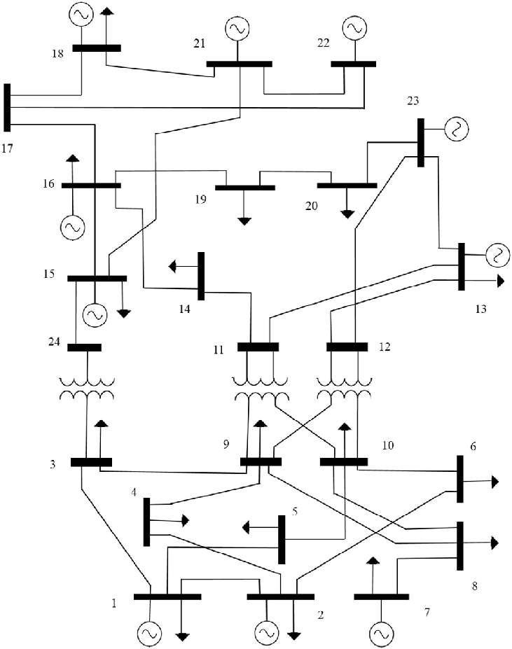
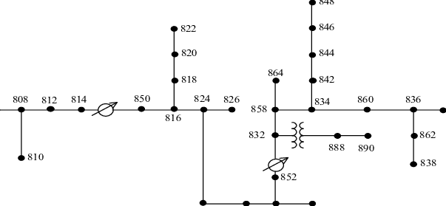
Transmission Grid vs. Distribution Grid
Differences between transmission system and distribution system
Fig. 4 IEEE 34 Bus Test System.
Fig. 3 IEEE 24 Bus Test System.
Meshed topology
Uni-directional power flows
Balanced lines and loads
Single phase analysis
Radial topology
Bi-directional power flows
Unbalanced lines and loads
Three phase analysis
ECE

Slide 13
Transmission Grid vs. Distribution Grid
Differences between transmission system and distribution system
Items | Transmission Network | Distribution Network
Topology | The general network topology is mesh-shaped and needs to be analyzed as a whole. | The power supply situation is regional power supply, the network topology in the region is radial, the closed-loop design between the regions, and the open-loop operation.
Network imbalance | The imbalance of the network is small and can basically be ignored. It can be considered that the three-phase line parameter balance and three-phase load balance can be analyzed in single-phase or positive sequence. | The three-phase line parameters are unbalanced, the R/X ratio fluctuates greatly, the three-phase load is unbalanced, and there are single-phase and two-phase loads, which cannot be analyzed independently.
SCADA measuring device | There are a large number of real-time measurement devices and a small number of pseudo-measurements, and the measurement redundancy is high. | A small amount of real-time measurement, a large number of load pseudo-measurement, from the perspective of real-time measurement, the measurement redundancy is low, and the network value is generally unobservable.
Network scale | A typical network generally contains hundreds of buses to one or two thousand buses. | A typical network generally contains 10,000 to 100,000 nodes.
Existing power plant | Generally, thermal power, large-scale hydropower and nuclear power generation, the output power is basically stable and adjustable with the load. | Mostly distributed DG distributed in the feeder of the distribution network, the output power fluctuates greatly, and has certain controllability.
ECE

Slide 14
The Concept of DSSE
Why do we need to perform DSSE-
With complex interactions in distribution networks and rapid growth of distributed energy resources (DER), electric vehicles, SCADA, and advanced metering infrastructure (AMI), DSSE is expected to become a significant function in monitoring and power management of smart grids by estimating the high accurate system states [5]-[6].
[5] “FERC staff report: Assessment of demand response and advanced metering - Dec. 2017.” [Online]. Available: https://www.ferc.gov/legal/
staff-reports/2017/DR-AM-Report2017.pdf.
[6] A. Primadianto and C. N. Lu, “A review on distribution system state estimation,” IEEE Trans. Power Syst., vol. 32, no. 5, pp. 3875–3883, Sep. 2017.
ECE

Slide 15
Transmission System SE vs Distribution System SE
System Analysis Process:
Transmission: Single phase analysis and one-line diagram of the system is configured.
Distribution: Unbalanced three-phase analysis and power flow constraints are necessary.
Data Availability:
Transmission: Data is over-determined (the number of available measurements is more than the number of estimations).
Distribution: As the number of meter points is much lower in the distribution network, most of the measurement data used in DSSE are pseudo measurements data.
ECE

Slide 16
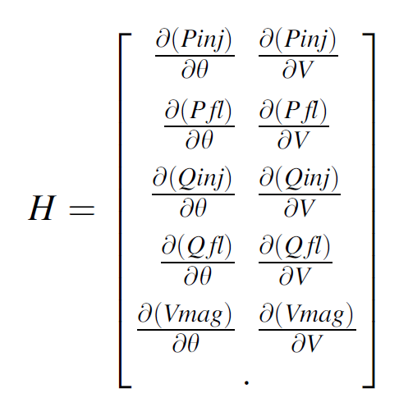
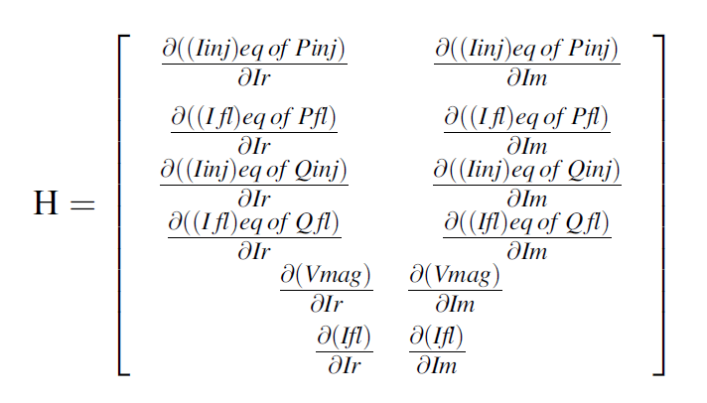
Transmission System SE vs Distribution System SE
Measurement Jacobian Matrix:
Transmission:
Distribution:
Reference: Sarada Devi, M. S. N. G., and G. Yesuratnam. "Comparison of State Estimation Process on Transmission and Distribution Systems." Advances in Decision Sciences, Image Processing, Security and Computer Vision. Springer, Cham, 2020. 414-423.
ECE

Slide 17
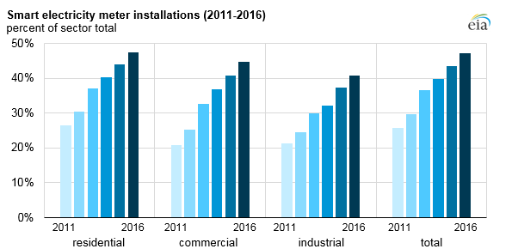
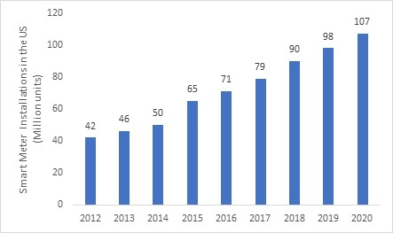
Distribution System Real-time Measurements
Fig. 5 Percent and numbers of Smart meter installations [7]
[7] Energy Information Administration. (2017) Annual Electric Power Industry Report. [Online]. Available:https://www.eia.gov/electricity/data/eia861/
ECE

Slide 18
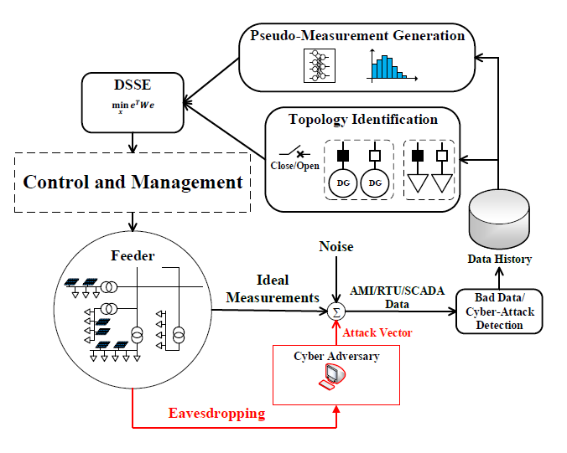
The Process of DSSE
Like transmission system SE, DSSE is the process of inferring the values of the distribution system’s state variables using a limited number of measured data at certain locations in the system [8].
Fig. 6 DSSE function in smart grid environment [9].
[8] A. Monticelli, State estimation in electric power systems: a generalized approach. Springer Science & Business Media, 1999.
[9] K. Dehghanpour, Z. Wang, J. Wang, Y. Yuan and F. Bu, "A Survey on State Estimation Techniques and Challenges in Smart Distribution Systems," in IEEE Transactions on Smart Grid, vol. 10, no. 2, pp. 2312-2322, March 2019.
ECE

Slide 19
The Method of DSSE
The selection of state variables in DSSE is separated into two categories:
Voltage-Based DSSE [10]-[12]
Branch Current-Based SE (BCSE) [13]-[15]
[10] M. E. Baran and A. W. Kelley, “State estimation for real-time monitoring of distribution systems,” IEEE Trans. Power Syst., vol. 9, no. 3, pp. 1601–1609, Aug. 1994
[11] D. A. Haughton and G. T. Heydt, “A linear state estimation formulation for smart distribution systems,” IEEE Trans. Power Syst., vol. 28, no. 2, pp. 1187–1195, May 2013.
[12] C. N. Lu, J. H. Tang, and W. H. E. Liu, “Distribution system state estimation,” IEEE Trans. Power Syst., vol. 10, no. 1, pp. 229–240, Feb. 1995.
[13] M. E. Baran and A. W. Kelley, “A branch-current-based state estimation method for distribution systems,” IEEE Trans. Power Syst., vol. 10, no. 1, pp. 483–491, Feb. 1995.
[14] M. Pau, P. A. Pegoraro, and S. Sulis, “Efficient branch-current-based distribution system state estimation including synchronized measurements,” IEEE Trans. Instrum. Meas., vol. 62, no. 9, pp. 2419–2429, Sep. 2013.
[15] M. E. Baran, J. Jung, and T. E. McDermott, “Including voltage measurements in branch current state estimation for distribution systems,” In IEEE Power & Energy Society General Meeting, pp. 1–5, Jul. 2009.
ECE

Slide 20
The Method of DSSE
Voltage-Based DSSE [10]-[12]
State variables: node voltage magnitude and angle.
Equations: WLS approach with PF, similar to the conventional SE method.
Shortage: High computational complexity, mainly used for meshed networks, sensitive to line parameters. May not work satisfactorily for networks with a high R/X ratio [16].
Branch Current-Based SE (BCSE) [13]-[15]
State variables: branch current and angle.
Equations: WLS approach and can be expressed using the rectangular or polar form.
BCSE is more insensitive to line parameters than the conventional node-voltage-based SE methods [9] and has better computation speed and memory usage [2].
[16] Mohamed Ben Ahmed and Anouar Abdelhakim Boudhir. 2018. Innovations in Smart Cities and Applications: Proceedings of the 2nd Mediterranean Symposium on Smart City Applications (1st ed.). Springer Publishing Company, Incorporated.
ECE

Slide 21
Branch Current-Based SE Algorithm
The three-phase branch current, also known as the state variables of the system, x can be expressed as:
Where $I_{l}^{ph,real}$ and $I_{l}^{ph,im}$ represent the real and imaginary parts of the three-phase branch current at branch $l$, respectively and $N$ represents the number of branches. The compact form can be expanded as:
ECE
Notes:
Taking the substation bus as the reference bus, a forward sweep procedure can find the node voltages by starting from the substation
and moving down the feeder visiting branches and updating the bus voltages at their receiving end by using the line equations.

Slide 22
Branch Current-Based SE Algorithm
The system measurements considered are power, current magnitude, and voltage magnitude measurements. They are derived as follows:
(1) Power flow Measurements:
where${ V}_{i}^{ph,k}$ is the estimated node voltage at the k-th iteration. The reason for converting all power measurements is to have linear relationships between the equivalent currents and the state variables as it can be observed from this equation.
ECE

Slide 23
Branch Current-Based SE Algorithm
(2) Current Magnitude Measurements:
(3) Voltage Magnitude Measurements:
where $V_{j}^{ph}$ is the substation voltage.
ECE

Slide 24
Branch Current-Based SE Algorithm
Detailed Algorithm:
-Step 1 Initialization:
Set the initial value of voltage at every node, such as 1 pu.
Backward Step: Using the injected power at every node, the values of state variables (branch current magnitudes and phase angles) are computed starting from the end of networks.
-Step 2 WLS
Using the WLS method, the state variable increments are obtained.
Update the value of state variables.
ECE

Slide 25
Branch Current-Based SE Algorithm
Detailed Algorithm:
-Step 3 Forward Step:
Using the new values of state variables, the values of nodal voltages are calculated starting from the substation.
-Step 4 Convergence Analysis
If the increments are smaller than the tolerance: stop. If not, return to step 2.
ECE

Slide 26
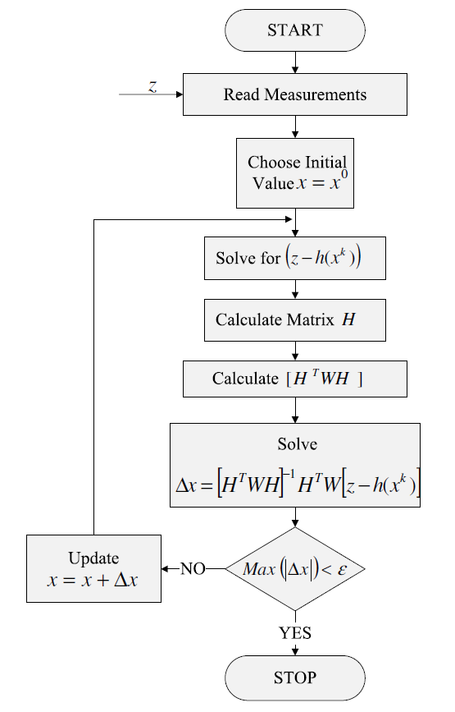
Block Diagram for solving WLS problem:
Start by sitting the iteration k = 0.
Initialize the node voltages.
Find the gain matrix G(x).
After obtaining the branch current estimate, update the node voltages using the forward sweeping approach.
Check for convergence, If no, update k = k + 1. Else, stop.
ECE

Slide 27
Contents
Introduction to State Estimation (SE)
The concept of SE
Conventional SE method
Introduction to Distribution System State Estimation (DSSE)
Transmission and distribution grids
The concept of DSSE
Conventional DSSE method
DSSE Research Topics
The challenges of DSSE
Observability problem
Metering device placement
Unbalanced problem
Topology configuration
Renewable integration
Robust DSSE methods
Smart meter data analysis
Conclusion
ECE

Slide 28
The Challenges of DSSE
Compared to transmission system SE, DSSE is facing some unique challenges due to the characteristics of the system[2]. These challenges include:
Low observability due to the lack of measurement device placements
Higher R/X ratio
Three-phase unbalanced system
Communication issues and network topology identification problem
Renewable energy and EV integration
Cyber-security issues
ECE

Slide 29
Observability Problem
Unlike transmission systems with a high data redundancy level, the distribution systems are generally undetermined with low observability.
“Observability” refers to the system operator’s ability to solve the SE problem. That depends on the number and location of metering devices.
Observability problem is one of the main challenges in applying transmission SE techniques to distribution systems directly [2].
In the traditional WLS-based SE method, the number of measurements must be larger than the estimated states.
The bad/missing measurement data also causes the observability problem.
ECE

Slide 30
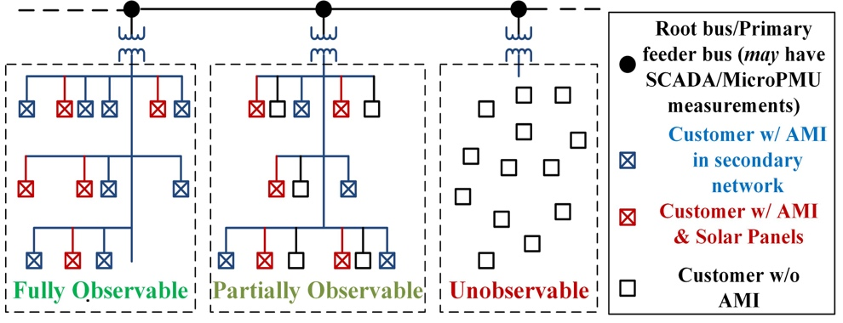
Observability Problem
Distribution systems can be divided into three groups according to observability: fully observable systems, partially observable systems, and fully unobservable systems.
Fig. 9 Distribution Systems with different observability.
ECE

Slide 31
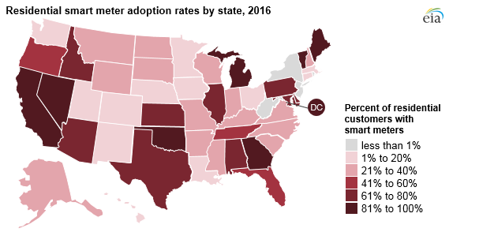
Observability Problem
Distribution System Real-time Measurements
Fig. 10 Percent of Residential Smart meter installation rate by state, 2016 [7].
ECE

Slide 32
Observability Problem
How to solve the observability problem-
Observability problem is addressed by generating pseudo-measurements when real measurements are unavailable [17].
Pseudo-measurements are artificially-generated data points based on the data history of the distribution systems.
Use of poor accurate pseudo-measurements will introduce high variance levels in the weight matrix, which could even lead to ill-conditioning of the DSSE problem [17].
[17] A. Angioni, T. Schlosser, F. Ponci, and A. Monti, “Impact of pseudo-measurements from new power profiles on state estimation in low-voltage grids,” IEEE Trans. Instrum. Meas., vol. 65, no. 1, pp. 70–77, Jan. 2016.
ECE

Slide 33
Observability Problem
The existing data-driven pseudo-measurement methods can be roughly separated into two categories,
Probabilistic and Statistical Approaches:
These methods employ spatial/temporal correlation and historic probability distribution data to generate reasonable pseudo-measurements and assess their uncertainty [18]-[21].
Encouraged to read:
[18] C. Muscas, M. Pau, P. A. Pegoraro, and S. Sulis, “Effects of measurements and pseudo-measurements correlation in distribution system state estimation,” IEEE Trans. Instrum. Meas., vol. 63, no. 12, pp. 2813–2823, Dec. 2014.
[19] A. K. Ghosh, D. L. Lubkeman, M. J. Downey, and R. H. Jones, “Distribution circuit state estimation using a probabilistic approach,” IEEE Trans. Power Syst., vol. 12, no. 1, pp. 45–51, Feb. 1997.
[20] R. Singh, B. C. Pal, and R. A. Jabr, “Statistical representation of distribution system loads using Gaussian mixture model,” IEEE Trans. Power Syst., vol. 25, no. 1, pp. 29–37, Feb. 2010.
[21] R. Singh, B. C. Pal, and R. A. Jabr, “Distribution system state estimation through Gaussian mixture model of the load as pseudo-measurement,” IET Gener. Transm. Distrib., vol. 4, no. 1, pp. 50–59, Jan. 2009.
ECE

Slide 34
Observability Problem
Existing data-driven pseudo-measurement method can be roughly separated into two categories:
Learning-Based Approaches:
Multiple machine learning algorithms have also been utilized to generate active/reactive power pseudo-measurement and uncertainty assessment [22]-[26].
Encouraged to read:
[22] B. P. Hayes, J. K. Gruber, and M. Prodanovic, “A closed-loop state estimation tool for MV network monitoring and operation,” IEEE Trans. Smart Grid, vol. 6, no. 4, pp. 2116–2125, Jul. 2015.
[23] D. Gerbec, S. Gasperic, I. Smon, and F. Gubina, “Allocation of the load profiles to consumers using probabilistic neural networks,” IEEE Trans. Power Syst., vol. 20, no. 2, pp. 548–555, May 2005.
[24] E. Manitsas, R. Singh, B. C. Pal, and G. Strbac, “Distribution system state estimation using an artificial neural network approach for pseudo measurement modeling,” IEEE Trans. Power Syst., vol. 27, no. 4, pp. 1888–1896, Nov. 2012.
[25] Y. Yuan, K. Dehghanpour, F. Bu, and Z. Wang, "A Multi-Timescale Data-Driven Approach to Enhance Distribution System Observability," IEEE Transactions on Power Systems, vol. 34, no. 4, pp. 3168-3177, July 2019.
[26] K. Dehghanpour, Y. Yuan, Z. Wang and F. Bu, "A Game-Theoretic Data-Driven Approach for Pseudo-Measurement Generation in Distribution System State Estimation," in IEEE Transactions on Smart Grid.
ECE

Slide 35
Metering Device Placement
Optimizing the location of meters in distribution systems is a significant subject for research, given the size of the system and potentially limited financial resources [9].
Objective Function | Constraints | Solution Algorithm
Meter cost [27] | Estimation accuracy | Heuristic search
Estimation accuracy [28] | Meter number | Mixed integer semidefinite optimization
Network observability [29] | NA | Heuristic search
Meter cost & estimation accuracy [30] | Estimation accuracy | Multi-Objective evolutionary
[27] M. E. Baran, J. Zhu, and A. W. Kelley, “Meter placement for real-time monitoring of distribution feeders,” IEEE Trans. Power Syst., vol. 11, no. 1, pp. 332–337, Feb. 1996.
[28] T. C. Xygkis, G. N. Korres, and N. M. Manousakis, “Fisher information based meter placement in distribution grids via the d-optimal experimental design,” IEEE Trans. Smart Grid, vol. 9, no. 2, pp. 1452–1461, Mar. 2018.
[29] B. Brinkmann and M. Negnevitsky, “A probabilistic approach to observability of distribution networks,” IEEE Trans. Power Syst., vol. 32, no. 2, pp. 1169–1178, Mar. 2017.
[30] S. Prasad and D. M. V. Kumar, “Trade-offs in PMU and IED deployment for active distribution state estimation using multi-objective evolutionary algorithm,” IEEE Trans. Instrum. Meas., vol. 67, no. 6, pp. 1298–1307, Jun 2018.
ECE

Slide 36
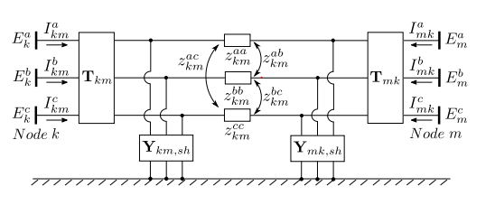
Three Phase unbalanced Problem
In distribution systems, loads can be three-phase, two-phase, or single-phase. Hence it is desirable to use a three-phase model in DSSE [14]. The basic WLS SE method was adapted for three-phase analysis to address the phase unbalanced problem [31].
Fig. 11 Three-phase branch model [30].
[31] U. Kuhar, M. Pantos, G. Kosec, and A. Svigelj, “The impact of model and measurement uncertainties on a state estimation in three-phase distribution networks,” to appear in IEEE Trans. Smart Grid.
ECE

Slide 37
Three Phase unbalanced Problem - Solution
Functions that relate measurements to the vector of state variables are developed from a three-phase branch model.
The BCSE method that was demonstrated earlier is modeled in three phases.
However, according to [30], the measurement uncertainties will impact estimation accuracy for different estimators, such as LAV, WLS, LMS, and SHGM.
Examples using different system models to achieve three-phase distribution state estimation can be found in [32-34]
[32] Langner, Andre L., and Ali Abur. "Formulation of three-phase state estimation problem using a virtual reference." IEEE Transactions on Power Systems 36.1 (2020): 214-223.
[33] A. Majumdar and B. C. Pal, "A three-phase state estimation in unbalanced distribution networks with switch modelling," 2016 IEEE First International Conference on Control, Measurement and Instrumentation (CMI), 2016, pp. 474-478, doi: 10.1109/CMI.2016.7413793.
[34] F. Magnago, L. Zhang and R. Nagarkar, "Three phase distribution state estimation utilizing common information model," 2015 IEEE Eindhoven PowerTech, 2015, pp. 1-6, doi: 10.1109/PTC.2015.7232515.
ECE

Slide 38
High R/X Ratio Problem
Distribution line with a high R/X ratio is another challenge for SE [6].
Recall the Jacobian Matrix H:
The high R/X ratio results in the ill‐conditioning of H matrix. In the transmission system, the off‐diagonal elements ∂P/∂V and ∂Q/∂θ are neglected, that is ∂P/∂V ≈ ∂Q/ ∂θ ≈ 0, because of weak coupling. With a high R/X ratio and strong coupling, the off‐diagonal elements cannot be discarded in the distribution system.
$$H\left(x\right)=\left[\begin{matrix}\frac{∂P_{b}}{∂V} & … & \frac{∂P_{L}}{∂V} \\ \frac{∂Q_{b}}{∂θ} & … & \frac{∂P_{L}}{∂θ}\end{matrix}\right]$$
ECE

Slide 39
High R/X Ratio Problem -Solution
To avoid the ill‐conditioning of H matrix, the P and Q measurements are handled by converting into equivalent current measurement I and making the H matrix independent of state variables equation.
The equivalent current measurement can be expressed with voltage or a current variable for every iteration k.
$$I_{phase a,b,c}^{k}={\left(\frac{P+jQ}{V^{k}}\right)}^{∗}$$
In this case, to address this challenge, branch current (BCSE) have been adopted as state variables, which turns out to be a more natural way of DSSE formulation [9].
[35] Bhattar, Poornachandratejasvi Laxman, Naran M. Pindoriya, and Anurag Sharma. "A combined survey on distribution system state estimation and false data injection in cyber‐physical power distribution networks." IET Cyber‐Physical Systems: Theory & Applications 6.2 (2021): 41-62.
ECE

Slide 40
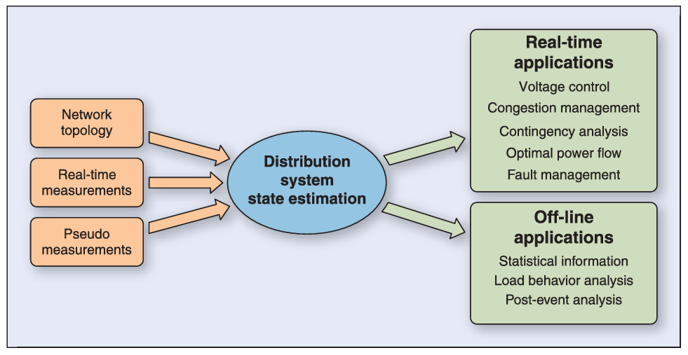
Topology Configuration
DSSE relies on the basic assumption that we know the exact network model so that we can write the measurement functions h(x). Hence, it is necessary to perform topology configuration process to identify the current topology.
Fig. 30 DSSE and possible associated applications into a DMS.
ECE

Slide 41
Topology Configuration
The existing topology configuration method can be roughly separated into two categories:
System Identification Approaches:
These methods assume the basic topology of the network is known to the system operator. However, due to local events, such as faults, line disconnections, switching events, etc, the basic topology will undergo local changes over time.
[36]-[40].
[36] G. N. Korres and N. M. Manousakis, “A state estimation algorithm for monitoring topology changes in distribution systems,” in Proc. IEEE Power Energy Soc. Gen. Meeting, San Diego, CA, USA, Jul. 2012, pp. 1–8.
[37] M. E. Baran, J. Jung, and T. E. McDermott, “Topology error identification using branch current state estimation for distribution systems,” In IEEE Transmission & Distribution Conference & Exposition: Asia and Pacific, pp. 1–4, Oct. 2009.
[38] D. Singh, J. P. Pandey, and D. S. Chauhan, “Topology identification, bad data processing, and state estimation using fuzzy pattern matching,” IEEE Trans. Power Syst., vol. 20, no. 3, pp. 1570–1579, Aug. 2005.
[39] G. Cavraro and R. Arghandeh, “Power distribution network topology detection with time-series signature verification method,” IEEE Trans. Power Syst., vol. 33, no. 4, pp. 3500–3509, Jul. 2018.
[40] W. Luan, J. Peng, M. Maras, J. Lo, and B. Harapnuk, “Smart meter data analytics for distribution network connectivity verification,” IEEE Trans. Smart Grid, vol. 6, no. 4, pp. 1964–1971, Jul. 2015.
ECE

Slide 42
Topology Configuration
The existing topology configuration method can be roughly separated into two categories:
Topology learning Approaches:
These methods assume that the system operator has very limited or no knowledge of the basic topology of the network. Hence, the objective is to learn the network’s topology using nodal and branch measurements [41]-[44].
[41] M. Babakmehr, M. G. Simões, M. B. Wakin, and F. Harirchi, “Compressive sensing-based topology identification for smart grids,” IEEE Trans. Ind. Informat., vol. 12, no. 2, pp. 532–543, Apr. 2016.
[42] Y. Weng, Y. Liao, and R. Rajagopal, “Distributed energy resources topology identification via graphical modeling,” IEEE Trans. Power Syst., vol. 32, no. 4, pp. 2682–2694, Jul. 2017.
[43] S. J. Pappu, N. Bhatt, R. Pasumarthy, and A. Rajeswaran, “Identifying topology of low voltage distribution networks based on smart meter data,” IEEE Trans. Smart Grid, vol. 9, no. 5, pp. 5113–5122, Sep. 2018.
[44] J. Yu, Y. Weng, and R. Rajagopal, “PaToPa: A data-driven parameter and topology joint estimation framework in distribution grids,” IEEE Trans. Power Syst., vol. 33, no. 4, pp. 4335–4347, Jul. 2018.
ECE

Slide 43
Renewable Energy Integration
The higher penetration of renewable power resources introduces a higher level of uncertainty in DSSE.
With the integration of DER and EV charging station, typical load patterns are becoming unreliable and uncertain.
The non-Gaussian distribution of renewable generation would adversely affect WLS-based DSSE methods [9].
Fast changes in system states can result in unreasonable errors of the WLS-based DSSE [45].
[45] Y. Weng, R. Negi, C. Faloutsos, and M. D. Ilic, “Robust data-driven state estimation for smart grid,” IEEE Trans. Smart Grid, vol. 8, no. 4, pp. 1956–1967, Jul. 2017.
ECE

Slide 44
Renewable Energy Integration
Probabilistic methods represent the major group of techniques for modeling the impacts of renewable uncertainty on DSSE [9].
Use GMM technique to obtain the non-Gaussian distribution of renewable power [46].
Use Beta distribution function to generate renewable pseudo-measurement [47].
[46] G. Valverde, A. T. Saric, and V. Terzija, “Stochastic monitoring of distribution networks including correlated input variables,” IEEE Trans. Power Syst., vol. 28, pp. 246–255, Feb. 2013.
[47] A. Angioni, T. Schlosser, F. Ponci, and A. Monti, “Impact of pseudo measurements from new power profiles on state estimation in low voltage grids,” IEEE Trans. Instrum. Meas., vol. 65, no. 1, pp. 70–77, Jan. 2016.
ECE

Slide 45
Cyber Security
Due to the vulnerability of the power system against cyber-attacks has been observed in practice, several common types of cyber-attack related to SE have been modeled in the literature:
False data injection [48]-[51]
Topology attacks [52]-[53]
Data privacy attacks [54]
[48] Q. Yang et al., “On false data-injection attacks against power system state estimation: Modeling and countermeasures,” IEEE Trans. Parallel Distrib. Syst, vol. 25, no. 3, pp. 717–729, Mar. 2014.
[49] S. Li, Y. Yilmaz, and X. Wang, “Quickest detection of false data injection attack in wide-area smart grids,” IEEE Trans. Smart Grid, vol. 6, no. 6, pp. 2725–2735, Nov. 2015.
[50] J. Liang, L. Sankar, and O. Kosut, “Vulnerability analysis and consequences of false data injection attack on power system state estimation,” IEEE Trans. Power Syst., vol. 31, no. 5, pp. 3864–3872, Sep. 2016.
[51] Y. Chakhchoukh and H. Ishii, “Enhancing robustness to cyber-attacks in power systems through multiple least trimmed squares state estimations,” IEEE Trans. Power Syst., vol. 31, no. 6, pp. 4395–4405, Nov. 2016.
[52] Y. Chakhchoukh and H. Ishii, “Coordinated cyber-attacks on the measurement function in hybrid state estimation,” IEEE Trans. Power Syst., vol. 30, no. 5, pp. 2487–2497, Sep. 2015.
[53] J. Zhang and L. Sankar, “Physical system consequences of unobservable state-and-topology cyber-physical attacks,” IEEE Trans. Smart Grid, vol. 7, no. 4, pp. 2016–2025, Jul. 2016.
[54] H. Li, L. Lai, and W. Zhang, “Communication requirement for reliable and secure state estimation and control in smart grid,” IEEE Trans. Smart Grid, vol. 2, no. 3, pp. 476–486, Sep. 2011.
ECE

Slide 46
Robust DSSE Methods
WLS estimator is a quadratic form of the maximum likelihood estimator and can be stated as the minimization of the weighted sum of squares. It is a fast and widely-used mathematical formulation. However, WLS is sensitive to bad data.
To handle the uncertainty of measurement data, alternative mathematical formulations have been proposed to increase the robustness of the state estimator.
ECE

Slide 47
Robust DSSE Methods
Least Absolute Value estimator (LAV): LAV estimator is based on the minimization of the $L_{1}$ norm of weighted measurement residual [55].
Schweppe Huber Generalised M (SHGM): SHGM estimator is an estimator that combines both WLS and WLAV [56].
Matrix completion: MC Utilizes a direct connection between the row and column elements within the matrix. The method can estimate missing values in the smart meter measurement matrices caused by low observability [57-58].
[55] R. Jabr, B. Pal, and R. Singh, “Choice of estimator for distribution system state estimation,” IET Generation, Transmission & Distribution, vol. 3, no. 7, pp. 666–678, Jul. 2009.
[56] Donti, Priya L., et al. "Matrix completion for low-observability voltage estimation." IEEE Transactions on Smart Grid 11.3, 2019, pp. 2520-2530.
[57] Zhang, Yingchen, et al. “State estimation in low-observable distribution systems using matrix completion.” National Renewable Energy Lab. (NREL), 2019.
[58] Liu, Bo, et al. "Robust matrix completion state estimation in distribution systems." 2019 IEEE Power & Energy Society General Meeting (PESGM). IEEE, 2019.
ECE

Slide 48
Smart Meter Data Analytics
Why is it important to perform SM data analytics-
The widespread popularity of SMs enables an immense amount of fine-grained electricity consumption data to be collected [59].
High-resolution data from SM provide rich information to understand the consumption behaviors of the consumers.
SM data provides a unique opportunity to develop a data-enabled modernized power system [60].
[59] Y. Wang, Q. Chen, T. Hong and C. Kang, "Review of Smart Meter Data Analytics: Applications, Methodologies, and Challenges," in IEEE Transactions on Smart Grid, vol. 10, no. 3, pp. 3125-3148, May 2019.
[60] H. Sun, Z. Wang, J. Wang, Z. Huang, N. Carrington and J. Liao, "Data-Driven Power Outage Detection by Social Sensors," in IEEE Transactions on Smart Grid, vol. 7, no. 5, pp. 2516-2524, Sept. 2016.
ECE

Slide 49
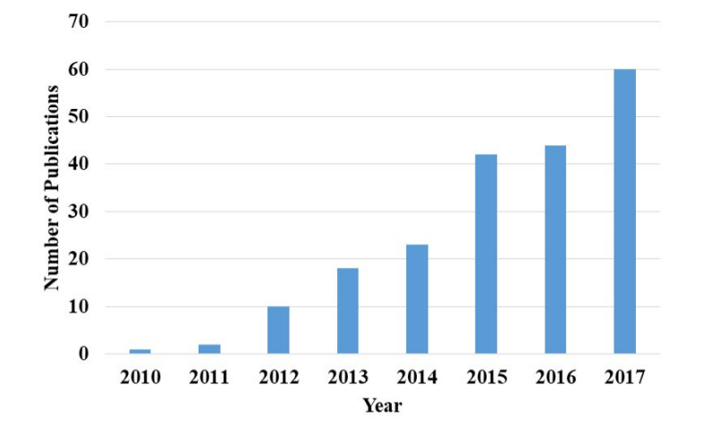
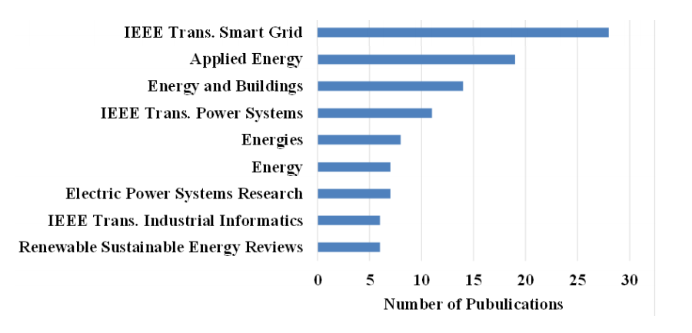
Smart Meter Data Analytics
Fig. 13 Number of publication about SM data analytics。
Fig. 14 Number of publications in most popular journals.
In 2010, the number of SM data analytics publications was at a low level.
The number of publications increased rapidly from 2012.
ECE

Slide 50
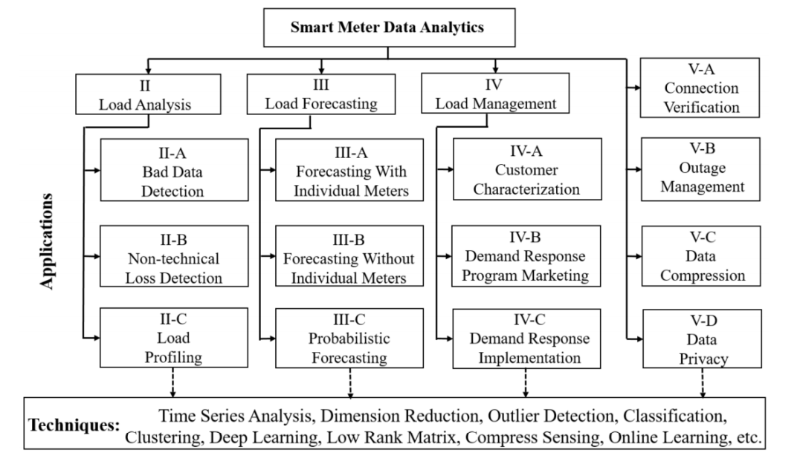
Smart Meter Data Analytics
Fig. 15 Taxonomy of SM data analytics。
ECE

Slide 51
Conclusions
The goal of DSSE is to infer the values of the distribution system’s state variables using a limited number of measured data. The DSSE is a numerical process to map data measurements to system state variables.
Technically, conventional transmission level SE approaches cannot be directly applied to the DSSE due to various challenges.
To address these challenges, different methods are proposed for DSSE. Most recent works are concentrated on using SM data analytics-based approaches to improve the conventional DSSE.
How to take advantage of massive SM data to enhance the efficiency of the demand side has become an important topic.
ECE

Slide 52
Appendix I: Matlab Example of Solving WLS Problem

Slide 53
A=importdata('H_data.m'); % import bus and line data with 5 columns, this is saved in another file
fbus=A(:,1); %From bus
tbus=A(:,2); %To bus
x=A(:,3); % Reactance in pu
Zm=A(:,4);% Impedance in pu
sig=A(:,5);% Susceptance in pu
buses=input('Enter the number of buses : \n');
B=input('Enter the reference bus : ');
for i=1:buses
H(i,fbus(i))=1/x(i);
H(i,tbus(i))=-1/x(i);
end
H(:,B)=[]; % Compute H matrix
for i=1:buses
R(i,i)=sig(i)^2; % Compute R Matrix
end
[nm,ns]=size(H);
if ns<nm
xest=[H'*R^-1*H]^-1*H'*R^-1*Zm; %Compute Gain matrix and forward sweep
else if ns==nm
xest=H^-1*Zm;
else if ns>nm
H'*[H*H']^-1*Zm;
end
end
end
Zt=H*xest; %True Value
e=Zm-Zt; %estimation error
fprintf(' The H Matrix \n');
disp(H);
fprintf(' The R inverse Matrix \n');
disp(R^-1);
fprintf('Estimated Value \n');
disp(xest);
fprintf('\n Measured value \n');
disp(Zm);
fprintf('\n True Value \n');
disp(Zt);
fprintf('\nError in equipment \n');
disp(e);

Slide 54
Display Results:
For 3 bus test case, use bus 1 as reference bus:
The H Matrix
-5.0000 0
0 -2.5000
-4.0000 4.0000
The R inverse Matrix
10000 0 0
0 10000 0
0 0 10000
Measured value
0.6000
0.4000
0.4050
True Value
0.7076
0.1848
0.2705
Error in equipment
-0.1076
0.2152
0.1345

Slide 55
Appendix II: VBSE Matlab Code Using WLS Method

Slide 56
The IEEE 14 bus system is used in this example.
Bus data:
% |Bus | Type | Vsp | theta | PGi | QGi | PLi | QLi | Qmin | Qmax |
busdata14 = [ 1 1 1.060 0 0 0 0 0 0 0;
2 2 1.045 0 40 42.4 21.7 12.7 -40 50;
3 2 1.010 0 0 23.4 94.2 19.0 0 40;
4 3 1.0 0 0 0 47.8 -3.9 0 0;
5 3 1.0 0 0 0 7.6 1.6 0 0;
6 2 1.070 0 0 12.2 11.2 7.5 -6 24;
7 3 1.0 0 0 0 0.0 0.0 0 0;
8 2 1.090 0 0 17.4 0.0 0.0 -6 24;
9 3 1.0 0 0 0 29.5 16.6 0 0;
10 3 1.0 0 0 0 9.0 5.8 0 0;
11 3 1.0 0 0 0 3.5 1.8 0 0;
12 3 1.0 0 0 0 6.1 1.6 0 0;
13 3 1.0 0 0 0 13.5 5.8 0 0;
14 3 1.0 0 0 0 14.9 5.0 0 0;];

Slide 57
Line Data:
% | From | To | R | X | B/2 | X'mer |
% | Bus | Bus | pu | pu | pu | TAP (a) |
linedata14 =[1 2 0.01938 0.05917 0.0264 1
1 5 0.05403 0.22304 0.0246 1
2 3 0.04699 0.19797 0.0219 1
2 4 0.05811 0.17632 0.0170 1
2 5 0.05695 0.17388 0.0173 1
3 4 0.06701 0.17103 0.0064 1
4 5 0.01335 0.04211 0.0 1
4 7 0.0 0.20912 0.0 0.978
4 9 0.0 0.55618 0.0 0.969
5 6 0.0 0.25202 0.0 0.932
6 11 0.09498 0.19890 0.0 1
6 12 0.12291 0.25581 0.0 1
6 13 0.06615 0.13027 0.0 1
7 8 0.0 0.17615 0.0 1
7 9 0.0 0.11001 0.0 1
9 10 0.03181 0.08450 0.0 1
9 14 0.12711 0.27038 0.0 1
10 11 0.08205 0.19207 0.0 1
12 13 0.22092 0.19988 0.0 1
13 14 0.17093 0.34802 0.0 1 ];

Slide 58
Measurement Data:
% Vi - 1, Pi - 2, Qi - 3, Pij - 4, Qij - 5, Iij - 6;
% |Msnt |Type | Value | From | To | Rii |
zdata14 = [ %---- Voltage Magnitude ------------%
1 1 1.06 1 0 9e-4;
%-----------------------------------%
%---- Real Power Injection ---------%
2 2 0.1830 2 0 1e-4;
3 2 -0.9420 3 0 1e-4;
4 2 0.00 7 0 1e-4;
5 2 0.00 8 0 1e-4;
6 2 -0.0900 10 0 1e-4;
7 2 -0.0350 11 0 1e-4;
8 2 -0.0610 12 0 1e-4;
9 2 -0.1490 14 0 1e-4;
%------------------------------------%
%---- Reactive Power Injection ------%
10 3 0.3523 2 0 1e-4;
11 3 0.0876 3 0 1e-4;
12 3 0.00 7 0 1e-4;
13 3 0.2103 8 0 1e-4;
14 3 -0.0580 10 0 1e-4;
15 3 -0.0180 11 0 1e-4;
16 3 -0.0160 12 0 1e-4;
17 3 -0.0500 14 0 1e-4;
%------------------------------------%
%------ Real Power Flow ------------- %
18 4 1.5708 1 2 64e-6;
19 4 0.7340 2 3 64e-6;
20 4 -0.5427 4 2 64e-6;
21 4 0.2707 4 7 64e-6;
22 4 0.1546 4 9 64e-6;
23 4 -0.4081 5 2 64e-6;
24 4 0.6006 5 4 64e-6;
25 4 0.4589 5 6 64e-6;
26 4 0.1834 6 13 64e-6;
27 4 0.2707 7 9 64e-6;
28 4 -0.0816 11 6 64e-6;
29 4 0.0188 12 13 64e-6;
%------------------------------------%
%------ Real Power Flow ------------- %
30 5 -0.1748 1 2 64e-6;
31 5 0.0594 2 3 64e-6;
32 5 0.0213 4 2 64e-6;
33 5 -0.1540 4 7 64e-6;
34 5 -0.0264 4 9 64e-6;
35 5 -0.0193 5 2 64e-6;
36 5 -0.1006 5 4 64e-6;
37 5 -0.2084 5 6 64e-6;
38 5 0.0998 6 13 64e-6;
39 5 0.1480 7 9 64e-6;
40 5 -0.0864 11 6 64e-6;
41 5 0.0141 12 13 64e-6;];
%--------------------------------------%

Slide 59
State Estimation using Weighted Least Square Method:
Parameter Settings:
num = 14; % IEEE - 14 bus system
ybus = ybusppg(num); % Get YBus
zdata = zdatas(num); % Get Measurement data
bpq = bbusppg(num); % Get B data
nbus = max(max(zdata(:,4)),max(zdata(:,5))); % Get number of buses
type = zdata(:,2); % Type of measurement, Vi - 1, Pi - 2, Qi - 3, Pij - 4, Qij - 5, Iij - 6
z = zdata(:,3); % Measuement values
fbus = zdata(:,4); % From bus
tbus = zdata(:,5); % To bus
Ri = diag(zdata(:,6)); % Measurement Error
V = ones(nbus,1); % Initialize the bus voltages
del = zeros(nbus,1); % Initialize the bus angles
E = [del(2:end); V]; % State Vector
G = real(ybus);
B = imag(ybus);
vi = find(type == 1); % Index of voltage magnitude measurements
ppi = find(type == 2); % Index of real power injection measurements
qi = find(type == 3); % Index of reactive power injection measurements
pf = find(type == 4); % Index of real powerflow measurements
qf = find(type == 5); % Index of reactive powerflow measurements
nvi = length(vi); % Number of Voltage measurements
npi = length(ppi); % Number of Real Power Injection measurements
nqi = length(qi); % Number of Reactive Power Injection measurements
npf = length(pf); % Number of Real Power Flow measurements
nqf = length(qf); % Number of Reactive Power Flow measurements
iter = 1;
tol = 5;

Slide 60
while(tol > 1e-4)
%Measurement Function, h
h1 = V(fbus(vi),1);
h2 = zeros(npi,1);
h3 = zeros(nqi,1);
h4 = zeros(npf,1);
h5 = zeros(nqf,1);
for i = 1:npi
m = fbus(ppi(i));
for k = 1:nbus
h2(i) = h2(i) + V(m)*V(k)*(G(m,k)*cos(del(m)-del(k)) + B(m,k)*sin(del(m)-del(k)));
end
end
for i = 1:nqi
m = fbus(qi(i));
for k = 1:nbus
h3(i) = h3(i) + V(m)*V(k)*(G(m,k)*sin(del(m)-del(k)) - B(m,k)*cos(del(m)-del(k)));
end
end
for i = 1:npf
m = fbus(pf(i));
n = tbus(pf(i));
h4(i) = -V(m)^2*G(m,n) - V(m)*V(n)*(-G(m,n)*cos(del(m)-del(n)) - B(m,n)*sin(del(m)-del(n)));
end
for i = 1:nqf
m = fbus(qf(i));
n = tbus(qf(i));
h5(i) = -V(m)^2*(-B(m,n)+bpq(m,n)) - V(m)*V(n)*(-G(m,n)*sin(del(m)-del(n)) + B(m,n)*cos(del(m)-del(n)));
end
h = [h1; h2; h3; h4; h5];
% Residue
r = z - h;

Slide 61
% Jacobian
% H11 - Derivative of V with respect to angles, All Zeros
H11 = zeros(nvi,nbus-1);
% H12 - Derivative of V with respect to V
H12 = zeros(nvi,nbus);
for k = 1:nvi
for n = 1:nbus
if n == k
H12(k,n) = 1;
end
end
end
% H21 - Derivative of Real Power Injections with Angles
H21 = zeros(npi,nbus-1);
for i = 1:npi
m = fbus(ppi(i));
for k = 1:(nbus-1)
if k+1 == m
for n = 1:nbus
H21(i,k) = H21(i,k) + V(m)* V(n)*(-G(m,n)*sin(del(m)-del(n)) + B(m,n)*cos(del(m)-del(n)));
end
H21(i,k) = H21(i,k) - V(m)^2*B(m,m);
else
H21(i,k) = V(m)* V(k+1)*(G(m,k+1)*sin(del(m)-del(k+1)) - B(m,k+1)*cos(del(m)-del(k+1)));
end
end
end

Slide 62
% H22 - Derivative of Real Power Injections with V
H22 = zeros(npi,nbus);
for i = 1:npi
m = fbus(ppi(i));
for k = 1:(nbus)
if k == m
for n = 1:nbus
H22(i,k) = H22(i,k) + V(n)*(G(m,n)*cos(del(m)-del(n)) + B(m,n)*sin(del(m)-del(n)));
end
H22(i,k) = H22(i,k) + V(m)*G(m,m);
else
H22(i,k) = V(m)*(G(m,k)*cos(del(m)-del(k)) + B(m,k)*sin(del(m)-del(k)));
end
end
end
% H31 - Derivative of Reactive Power Injections with Angles
H31 = zeros(nqi,nbus-1);
for i = 1:nqi
m = fbus(qi(i));
for k = 1:(nbus-1)
if k+1 == m
for n = 1:nbus
H31(i,k) = H31(i,k) + V(m)* V(n)*(G(m,n)*cos(del(m)-del(n)) + B(m,n)*sin(del(m)-del(n)));
end
H31(i,k) = H31(i,k) - V(m)^2*G(m,m);
else
H31(i,k) = V(m)* V(k+1)*(-G(m,k+1)*cos(del(m)-del(k+1)) - B(m,k+1)*sin(del(m)-del(k+1)));
end
end
end

Slide 63
% H32 - Derivative of Reactive Power Injections with V
H32 = zeros(nqi,nbus);
for i = 1:nqi
m = fbus(qi(i));
for k = 1:(nbus)
if k == m
for n = 1:nbus
H32(i,k) = H32(i,k) + V(n)*(G(m,n)*sin(del(m)-del(n)) - B(m,n)*cos(del(m)-del(n)));
end
H32(i,k) = H32(i,k) - V(m)*B(m,m);
else
H32(i,k) = V(m)*(G(m,k)*sin(del(m)-del(k)) - B(m,k)*cos(del(m)-del(k)));
end
end
end
% H41 - Derivative of Real Power Flows with Angles
H41 = zeros(npf,nbus-1);
for i = 1:npf
m = fbus(pf(i));
n = tbus(pf(i));
for k = 1:(nbus-1)
if k+1 == m
H41(i,k) = V(m)* V(n)*(-G(m,n)*sin(del(m)-del(n)) + B(m,n)*cos(del(m)-del(n)));
else if k+1 == n
H41(i,k) = -V(m)* V(n)*(-G(m,n)*sin(del(m)-del(n)) + B(m,n)*cos(del(m)-del(n)));
else
H41(i,k) = 0;
end
end
end
end

Slide 64
% H42 - Derivative of Real Power Flows with V
H42 = zeros(npf,nbus);
for i = 1:npf
m = fbus(pf(i));
n = tbus(pf(i));
for k = 1:nbus
if k == m
H42(i,k) = -V(n)*(-G(m,n)*cos(del(m)-del(n)) - B(m,n)*sin(del(m)-del(n))) - 2*G(m,n)*V(m);
else if k == n
H42(i,k) = -V(m)*(-G(m,n)*cos(del(m)-del(n)) - B(m,n)*sin(del(m)-del(n)));
else
H42(i,k) = 0;
end
end
end
end
% H51 - Derivative of Reactive Power Flows with Angles
H51 = zeros(nqf,nbus-1);
for i = 1:nqf
m = fbus(qf(i));
n = tbus(qf(i));
for k = 1:(nbus-1)
if k+1 == m
H51(i,k) = -V(m)* V(n)*(-G(m,n)*cos(del(m)-del(n)) - B(m,n)*sin(del(m)-del(n)));
else if k+1 == n
H51(i,k) = V(m)* V(n)*(-G(m,n)*cos(del(m)-del(n)) - B(m,n)*sin(del(m)-del(n)));
else
H51(i,k) = 0;
end
end
end
end

Slide 65
% H52 - Derivative of Reactive Power Flows with V..
H52 = zeros(nqf,nbus);
for i = 1:nqf
m = fbus(qf(i));
n = tbus(qf(i));
for k = 1:nbus
if k == m
H52(i,k) = -V(n)*(-G(m,n)*sin(del(m)-del(n)) + B(m,n)*cos(del(m)-del(n))) - 2*V(m)*(-B(m,n)+ bpq(m,n));
else if k == n
H52(i,k) = -V(m)*(-G(m,n)*sin(del(m)-del(n)) + B(m,n)*cos(del(m)-del(n)));
else
H52(i,k) = 0;
end
end
end
end
% Measurement Jacobian, H..
H = [H11 H12; H21 H22; H31 H32; H41 H42; H51 H52];
% Gain Matrix, Gm..
Gm = H'*inv(Ri)*H;
%Objective Function
J = sum(inv(Ri)*r.^2);
% State Vector
dE = inv(Gm)*(H'*inv(Ri)*r);
E = E + dE;
del(2:end) = E(1:nbus-1);
V = E(nbus:end);
iter = iter + 1;
tol = max(abs(dE));
end

Slide 66
Display Results:
--- State Estimation ---
----------------------------
| Bus | V | Angle |
| No | pu | Degree |
--------------------------
1 1.0068 0.0000
2 0.9899 -5.5265
3 0.9518 -14.2039
4 0.9579 -11.4146
5 0.9615 -9.7583
6 1.0185 -16.0798
7 0.9919 -14.7510
8 1.0287 -14.7500
9 0.9763 -16.5125
10 0.9758 -16.7476
11 0.9932 -16.5397
12 1.0009 -17.0203
13 0.9940 -17.0583
------------------------------
Del = 180/pi*del;
E2 = [V Del]; % Bus Voltages and angles..
disp('-------- State Estimation ------------------');
disp('--------------------------');
disp('| Bus | V | Angle | ');
disp('| No | pu | Degree | ');
disp('--------------------------');
for m = 1:n
fprintf('%4g', m); fprintf(' %8.4f', V(m)); fprintf(' %8.4f', Del(m)); fprintf('\n');
end
disp('---------------------------------------------');
You should get this in the console:

Slide 67
Appendix III: Three-Phase BCSE Matlab Code Using WLS Method with Power Flow Constraints

Slide 68
Case Study:
Three-Phase BCSE using WLS method using IEEE 13 bus test feeder:
IEEE 13 Bus data example:

Slide 69
Importing data from file
BUS=importdata(’13bus.txt’,delimiterIn,headerlinesIn); %import bus data
BRANCH=importdata(’13branch.txt’,delimiterIn,headerlinesIn); %import line data
BUSM=importdata(’13busM.txt’,delimiterIn,headerlinesIn); %import measurement for a concrete network
bus=BUS.data(:,1);
v_0=BUS.data(:,2); v_1=BUS.data(:,3); v_2=BUS.data(:,4);
dd_0=BUS.data(:,5)*pi/180; dd_1=BUS.data(:,6)*pi/180;dd_2=BUS.data(:,7)*pi/180;
Pgen_0=BUS.data(:,8); Pgen_1=BUS.data(:,9); Pgen_2=BUS.data(:,10);
Qgen_0=BUS.data(:,11); Qgen_1=BUS.data(:,12); Qgen_2=BUS.data(:,13);
branch=BRANCH.data(:,1);
from=BRANCH.data(:,2); to=BRANCH.data(:,3); %formation of R,X matrix
r_00=BRANCH.data(:,4); r_01=BRANCH.data(:,5); r_02=BRANCH.data(:,6);
r_10=BRANCH.data(:,7); r_11=BRANCH.data(:,8); r_12=BRANCH.data(:,9);
r_20=BRANCH.data(:,10); r_21=BRANCH.data(:,11); r_22=BRANCH.data(:,12);
x_00=BRANCH.data(:,13); x_01=BRANCH.data(:,14); x_02=BRANCH.data(:,15); x_10=BRANCH.data(:,16);
x_11=BRANCH.data(:,17); x_12=BRANCH.data(:,18); x_20=BRANCH.data(:,19); x_21=BRANCH.data(:,20);
x_22=BRANCH.data(:,21); PhaseA=BRANCH.data(:,22); PhaseB=BRANCH.data(:,23); PhaseC=BRANCH.data(:,24);
Trans=BRANCH.data(:,25); ft=BRANCH.data(:,26)*0.000189393939; busM=BUSM.data(:,1); Pload_0m=BUSM.data(:,2);
Pload_1m=BUSM.data(:,3); Pload_2m=BUSM.data(:,4); Qload_0m=BUSM.data(:,5); Qload_1m=BUSM.data(:,6); Qload_2m=BUSM.data(:,7);

Slide 70
Declaration of symbolic variable
Ppq_0=sym(’Ppq_0’,[1 length(branch)]); % create three 1×length(branch) vectors of symbolic variables.
Ppq_1=sym(’Ppq_1’,[1 length(branch)]);
Ppq_2=sym(’Ppq_2’,[1 length(branch)]);
PL_0=sym(’PL_0’,[1 length(bus)]);
PL_1=sym(’PL_1’,[1 length(bus)]);
PL_2=sym(’PL_2’,[1 length(bus)]);
AN=subs(A,X,Xlambda(1:length(X))); %Evaluation of symbolic variable
BN=subs(B,X,Xlambda(1:length(X)));
PL_0m=nonzeros(Pload_0m/Sbase1P); %vector P L_0m will contain active loads just for buses which have defined load in phase zero
PL_1m=nonzeros(Pload_1m/Sbase1P);
PL_2m=nonzeros(Pload_2m/Sbase1P);
PL_0m=nonzeros(Qload_0m/Sbase1P);
QL_1m=nonzeros(Qload_1m/Sbase1P);
QL_2m=nonzeros(Qload_2m/Sbase1P);
Notes:
Symbolic MATLAB Toolbox provides symbolic calculation in MATLAB environment. Doing symbolic calculus is one of the more useful things that MATLAB can perform. Symbolic variables are necessary when the objects to be manipulated are not just numbers but rather expressions involving mathematical variables. Symbolic variables belongs to the class sym (defined by the Symbolic Toolbox). Thus, in order to perform symbolic computations with a certain set of variables, first they need to be declared as a variables from that class. In this example, voltage magnitudes and angles, active and reactive power and load flow are symbolic quantities.

Slide 71
Slack bus voltage and admittance matrix
V_01=BUS.data(1,2); % Voltage and angle for slack bus 1
V_11=BUS.data(1,3);
V_21=BUS.data(1,4);
d_01=BUS.data(1,5)*pi/180;
d_11=BUS.data(1,6)*pi/180;
d_21=BUS.data(1,7)*pi/180;
for k=1:length(branch)
Zpu1=ybase*ft(k)*[r_00(k)+1i*x_00(k)r_01(k)+1i*x_01(k)
r_02(k)+1i*x_02(k)];
Zpu2=ybase*ft(k)*[r_10(k)+1i*x_10(k)r_11(k)+1i*x_11(k)
r_12(k)+1i*x_12(k)];
Zpu3=ybase*ft(k)*[r_20(k)+1i*x_20(k)r_21(k)+1i*x_21(k)
r_22(k)+1i*x_22(k)];
Zpu=[Zpu1(Zpu1~=0);Zpu2(Zpu2~=0);Zpu3(Zpu3~=0)];ypu=inv(Zpu);
Y=abs(ypu); % Admittance matrix
thetapp=atan2(imag(ypu),real(ypu)); % Phase angle Theta
thetapq=atan2(-imag(ypu),-real(ypu));
end

Slide 72
Power Balance Equality constraints
for n=2:Nn
sumP_0=0;
for k=1:length(branch)
if ismember(n,from(k))&PhaseA(k)~=0
sumP_0=sumP_0+Ppq_0(k);
elseif ismember(n,to(k))&PhaseA(k)~=0
sumP_0=sumP_0+Pqp_0(k);
end;
end;
sumP_0=Pgen_0(n)-Pload_0-sumP_0;
end
where active and reactive power flows from node p to node q for phase
zero is given by:
for k=1:length(branch)
for p=1:Nn
for q=1:Nn
if ismember(p,from(k))&ismember(q,to(k))&PhaseA(k)~=0
CPpq_0=Ppq_0(k)-(V_0(p)_V_0(p)_Y(1,1)_cos(d_0(p)-d_0(p)-thetapp(1,1))+V_0(p)_V_0(q)_Y(1,1)_cos(d_0(p)-d_0(q)-thetapq(1,1))+V_0(p)_V_1(p)_Y(1,2)_cos(d_0(p)-d_1(p)-thetapp(1,2))+V_0(p)_V_1(q)_Y(1,2)_cos(d_0(p)-d_1(q)-thetapq(1,2))+V_0(p)_V_2(p)_Y(1,3)_cos(d_0(p)-d_2(p)-thetapp(1,3))+V_0(p)_V_2(q)_Y(1,3)_cos(d_0(p)-d_2(q)-thetapq(1,3)));
elseif PhaseA(k)==0
CPpq_0=[];end;end;
end
end
Notes:
Equality constraints are given as power balance for each node and all three phases. Note that load power is defined just for those nodes where load is placed, and for all other it is set to zero,

Slide 73
Definition of all matrix
%Matrix of equality constraints
Con=[Eq1 Eq2];
%Matrix of variables
X=[V_0(2:length(V_0)) V_1(2:length(V_1)) V_2(2:length(V_2))
d_0(2:length(d_0)) d_1(2:length(d_1)) d_2(2:length(d_2))
Ppq Qpq PL_0P L_1 PL_2 QL_0 QL_1 QL_2];
%Matrix C, Jacobian Matrix
C=jacobian(Con,X);
%Matrix delta Z(k) , derivative of Objective
dzk=gradient(Objec,X);
%Matrix ck, the conjugate of Z
ck=Con.’;
%Matrix W, diagonal matrix of weights associated with each measurement.
W=diag(W1);
%Matrix A(leftside )AxX=B
A=[W C';C zeros(length(Con),length(Con))];
%Matrix B(rightside) AxX=B
B=[-W*dzk; -ck];
Notes:
Matrix C is defined using MATLAB function jacobian. It represents partial derivatives of equality constraints with respect to the state variables. Matrix W is a diagonal matrix of weights associated to each measurement.
With all matrices defined Gauss-Newton method can be described as iterative process for solving vector X in the matrix equation A×X = B

Slide 74
Assign Initial Values
% initial values for buses
v_0=BUS.data(:,2);
v_1=BUS.data(:,3);
v_2=BUS.data(:,4);
dd_0=BUS.data(:,5)_pi/180;
dd_1=BUS.data(:,6)_pi/180;
dd_2=BUS.data(:,7)_pi/180;
Pload_0m=BUSM.data(:,2);
Pload_1m=BUSM.data(:,3);
Pload_2m=BUSM.data(:,4);
Qload_0m=BUSM.data(:,5);
Qload_1m=BUSM.data(:,6);
Qload_2m=BUSM.data(:,7);
L=ones(1,length(Con));
% initial values for variables
Xlambda=[V_0(2:length(V_0))V_1(2:length(V_1))V_2(2:length(V_2))
d_0(2:length(d_0)) d_1(2:length(d_1)) d_2(2:length(d_2))
Ppq Qpq PL_0 PL_1 PL_2 QL_0 QL_1 QL_2-L];

Slide 75
Gauss-Newton algorithm
% tolerance (stopping criteria)
eps=1e−5;
%tolerance calculated in loop
epsObtained=1;
%number of iterations
iteration = 0;
while(eps<epsObtained)
%in A and B substitute variables in X with first length(X) values in Xlambda
AN=subs(A,X,Xlambda(1:length(X)));
BN=subs(B,X,Xlambda(1:length(X)));
% calculation of numbers
ANE=eval(AN);
BNE=eval(BN);
% check convergence for constraints
absB=abs(BNE(length(X)+1:length(BNE)));
epsObtained=max(absB);
%calculation of dX=inv(A)_B
dX=inv(ANE)_BNE;
%update new values X(k+1)=X(k)+dX (update just variables,not lambda)
Xlambda=Xlambda(1:length(X))'+dX(1:length(X));
Xlambda=Xlambda';
iteration=iteration+1; % number of iterations
end
Display Results
%This will display total number of iterations, achieved tolerance and estimated state vector values.
iteration
epsObtained
Xlambda(1:length(X))’
Notes:
With initial values defined, Gauss- Newton algorithm is lunched. Convergence criteria is set to 10−5. The algorithm is repeated until convergence occurs. MATLAB functions subs and eval are used to replaces all the variables in the symbolic expression with initial values and evaluate the numerical value in the string expression, respectively.

Slide 76
Appendix IV: Branch Current based State Estimation Using WLS and Artificial Neural Network

Slide 77
V_true_mag_total = [];
V_true_phase_total =[];
error_voltage_mag = [];
error_voltage_phase = [];
error_voltage_real = [];
error_voltage_img = [];
test = [];
record_time = [];
%load error
w=3;
P_start=[0.2,0.2,0.2,0.2,0.2];
%for w = 10:10:60
test_error_current_real = [];
test_error_current_img = [];
test_error_current_mag = [];
test_error_current_phase = [];
test_error_voltage_mag = [];
test_error_voltage_phase = [];
record_x_true_full = [];
record_z_wls = [];
P_load_est = [];
Q_load_est = [];
record_final_residual = [];
record_test = [];
p_value = [];
phase_est_total =[];
mag_est_total = [];
phase_true_total =[];
mag_true_total = [];
V_result_mag_total = [];
V_result_phase_total =[];
%impedance
load('line_impedance_1.mat');
from_bus = Lineimpedance(:,1);
to_bus = Lineimpedance(:,2);
temp = from_bus(~isnan(from_bus));
from_bus = temp;
temp = to_bus(~isnan(to_bus));
to_bus = temp;
clear temp;
for q = 1:1
tic
error_percen_full = [];
error_current_mag = [];
error_current_phase = [];
error_current_real = [];
error_current_img = [];
phase_est_final =[];
mag_est_final = [];
bus_list= union(from_bus,to_bus);
bus_num = length(bus_list);
line_num = length(from_bus);
Z_pu = [Lineimpedance(:,3)+1j*Lineimpedance(:,6),Lineimpedance(:,4)+1j*Lineimpedance(:,7),Lineimpedance(:,5)+1j*Lineimpedance(:,8)];
phase_no_line = cell(1,3);
phase_no_bus = cell(1,3);
z_pu = cell(1,line_num);
unbalance = cell(1,line_num);
% Base Selection
S_base = 1000/3;
V_base = 13.8/sqrt(3);
I_base = S_base/(V_base);
Z_base = V_base*1000/I_base;
time_point = q;

Slide 78
for i = 1:line_num
z_pu{i} = Z_pu(3*(i-1)+1:3*i,1:3);
unbalance{i}=find(any(z_pu{i})==0);
for j=1:3
if nnz(ismember(unbalance{i},j))>0
phase_no_line{j}=[phase_no_line{j};i];
phase_no_bus{j}=[phase_no_bus{j};to_bus(i)];
end
end
end
%real current
load('allcurrents_line_head_end.mat');
line_current = [];
for i = 1:2:34
line_current = [line_current;allcurrents_line_head_end(time_point,6*(i-1)+1:6*i)];
end
temp_i = line_current;
for i = 1:line_num
I(i,:)=[(temp_i(i,1)+1i*temp_i(i,2)),(temp_i(i,3)+1i*temp_i(i,4)),(temp_i(i,5)+1i*temp_i(i,6))];
end
I=I/I_base;
x_true = cell(1,3);
x_ture_mag = cell(1,3);
x_ture_phase = cell(1,3);
for i = 1:3
I_r(:,i)=real(I(:,i));
I_i(:,i)=imag(I(:,i));
x_true{i} = [I_r(:,i);I_i(:,i)];
x_true_real{i} = I_r(:,i);
x_true_img{i} = I_i(:,i);
x_true{i}(phase_no_line{i})=[];
x_true{i}(phase_no_line{i}+line_num-length(phase_no_line{i}))=[];
x_true_real{i}(phase_no_line{i})=[];
x_true_real{i}(phase_no_line{i}+line_num-length(phase_no_line{i}))=[];
x_true_img{i}(phase_no_line{i})=[];
x_true_img{i}(phase_no_line{i}+line_num-length(phase_no_line{i}))=[];
end

Slide 79
x_true_full=[x_true{1};x_true{2};x_true{3}];
x_true_real_full=[x_true_real{1};x_true_real{2};x_true_real{3}];
x_true_img_full=[x_true_img{1};x_true_img{2};x_true_img{3}];
record_x_true_full = [record_x_true_full,x_true_full];
%all meter real measurement
z_1 = I(1,:);
for i = 1:18
V_true_real(i,:) = [V_true(6*(i-1)+1),V_true(6*(i-1)+3),V_true(6*(i-1)+5)];
V_true_img(i,:) = [V_true(6*(i-1)+2),V_true(6*(i-1)+4),V_true(6*i)];
end
[V_true_phase,V_true_mag] = cart2pol(V_true_real,V_true_img);
%Load data
temp = xlsread('BUS_NUMBER.xlsx');
temp = temp(:,3:5);
temp(1,:)=[];
load_pu = [];
load('load_data.mat')
for i = 1:length(temp)
load_pu(i,:)=[((P_load(time_point,i)+1j*Q_load(time_point,i))*temp(i,1)/sum(temp(i,:))),((P_load(time_point,i)+1j*Q_load(time_point,i))*temp(i,2)/sum(temp(i,:))),((P_load(time_point,i)+1j*Q_load(time_point,i))*temp(i,3)/sum(temp(i,:)))];
end
load_pu = load_pu/S_base;
load_pu_P=real(load_pu);
load_pu_Q=imag(load_pu);
z_1 = [real(z_1);imag(z_1)];
% Substation Voltage data
load('voltage_data.mat');
V_real = zeros(bus_num,3);
V = allvoltages_rectangular_coordinates(time_point,1:6)/(V_base*1000);
%create true voltage data
V_true = allvoltages_rectangular_coordinates(time_point,:)/(V_base*1000);
V_true_real = zeros(18,3);
V_true_img = zeros(18,3);

Slide 80
residual_real=[];
residual_img = [];
load('end_bus_0load.mat')
% run x times to stable random Gaussian error
for number = 1:1
V_ref_1_real = normrnd(V(1,1),abs(V(1,1))*3/(3*100));
V_ref_1_imag = normrnd(V(1,2),abs(V(1,2))*3/(3*100));
V_ref_2_real = normrnd(V(1,3),abs(V(1,3))*3/(3*100));
V_ref_2_imag = normrnd(V(1,4),abs(V(1,4))*3/(3*100));
V_ref_3_real = normrnd(V(1,5),abs(V(1,5))*3/(3*100));
V_ref_3_imag = normrnd(V(1,6),abs(V(1,6))*3/(3*100));
V_real(1,:)=[V_ref_1_real+1i*V_ref_1_imag V_ref_2_real+1i*V_ref_2_imag V_ref_3_real+1i*V_ref_3_imag];
V_ref = V_real(1,:);
%set some error for initial guess current value
I = 0.2*I;
% Build h
h=zeros(2*bus_num-2,2*line_num);
for i=2:bus_num
for j=1:line_num
if to_bus(j)==i
h(i-1,j)=1;
h(i+bus_num-2,j+line_num)=1;
else
if from_bus(j)==i
h(i-1,j)=-1;
h(i+bus_num-2,j+line_num)=-1;
end
end
end
end
weight = [1*10^-5*ones(34,1);1*10^-6*ones(2,1)];
temp_weight = repmat(weight,3);
temp_weight(:,2:3)=[];
convergence = [];
sigma_pse_P=abs(load_pu_P)*w/(3*100);
sigma_pse_Q=abs(load_pu_Q)*w/(3*100);
%Forward Sweep
for i = 1:17
V_real(to_bus(i),:) = V_real(from_bus(i),:)-(Z_pu(3*(i-1)+1:3*i,:)*I(i,:).').';
end

Slide 81
load_pu_P_n=normrnd(load_pu_P,sigma_pse_P);
load_pu_Q_n=normrnd(load_pu_Q,sigma_pse_Q);
load_pu_n=(load_pu_P_n+1j*load_pu_Q_n);
%real; add error for real measurement
sigma_real=abs(z_1)*3/(3*100);
z_1_n=normrnd(z_1,sigma_real);
I_r=zeros(line_num,3);
I_i=zeros(line_num,3);
x_est_old=cell(1,3);
x_est_old_full=[];
for i=1:3
I_r(:,i)=real(I(:,i));
I_i(:,i)=imag(I(:,i));
x_est_old{i}=[I_r(:,i);I_i(:,i)];
x_est_old{i}(phase_no_line{i})=[];
x_est_old{i}(phase_no_line{i}+line_num-length(phase_no_line{i}))=[];
x_est_old_full=[x_est_old_full;x_est_old{i}];
end
h_wls=cell(1,3);
for i=1:3
% P & Q
h1=zeros(2,2*line_num);
h1(1,1)=1;
h1(2,1+line_num)=1;
h2=zeros(2,2*line_num);
h2(1,2)=1;
h2(2,2+line_num)=1;
h3=zeros(2,2*line_num);
h3(1,3)=1;
h3(2,3+line_num)=1;
h4=zeros(2,2*line_num);
h4(1,4)=1;
h4(2,4+line_num)=1;
h5=zeros(2,2*line_num);
h5(1,5)=1;
h5(2,5+line_num)=1;
h6=zeros(2,2*line_num);
h6(1,6)=1;
h6(2,6+line_num)=1;
V_real(1,:)=[];
pse=conj(load_pu_n./V_real);
z=zeros(2*bus_num-2,3);
for i=1:3
z(:,i)=[real(pse(:,i));imag(pse(:,i))];
end

Slide 82
h7=zeros(2,2*line_num);
h7(1,7)=1;
h7(2,7+line_num)=1;
h8=zeros(2,2*line_num);
h8(1,8)=1;
h8(2,8+line_num)=1;
h9=zeros(2,2*line_num);
h9(1,9)=1;
h9(2,9+line_num)=1;
h10=zeros(2,2*line_num);
h10(1,10)=1;
h10(2,10+line_num)=1;
h11=zeros(2,2*line_num);
h11(1,11)=1;
h11(2,11+line_num)=1;
h12=zeros(2,2*line_num);
h12(1,12)=1;
h12(2,12+line_num)=1;
h13=zeros(2,2*line_num);
h13(1,13)=1;
h13(2,13+line_num)=1;
h14=zeros(2,2*line_num);
h14(1,14)=1;
h14(2,14+line_num)=1;
h15=zeros(2,2*line_num);
h15(1,15)=1;
h15(2,15+line_num)=1;
h16=zeros(2,2*line_num);
h16(1,16)=1;
h16(2,16+line_num)=1;
h17=zeros(2,2*line_num);
h17(1,17)=1;
h17(2,17+line_num)=1;
h_wls{i}=[h;h1];
h_wls{i}(:,phase_no_line{i})=[];
h_wls{i}(:,phase_no_line{i}+line_num-length(phase_no_line{i}))=[];
end
% Build full H
[m1,n1]=size(h_wls{1});
[m2,n2]=size(h_wls{2});
[m3,n3]=size(h_wls{3});
h_wls_full=zeros(m1+m2+m3,n1+n2+n3);
h_wls_full(1:m1,1:n1)=h_wls{1};
h_wls_full(m1+1:m1+m2,n1+1:n1+n2)=h_wls{2};
h_wls_full(m1+m2+1:m1+m2+m3,n1+n2+1:n1+n2+n3)=h_wls{3};
z_wls=cell(1,3);
z_wls_full=[];
for i=1:3
z_wls{i}=[z(:,i);z_1_n(:,i)];
z_wls_full=[z_wls_full;z_wls{i}];
end

Slide 83
h_zero_index=all(h_wls_full==0, 2);
h_wls_full(h_zero_index,:)=[];
z_wls_full(h_zero_index)=[];
record_z_wls = [record_z_wls,z_wls_full];
%SE loop
iter = 0;
while 1
Rinv_full=eye(length(z_wls_full));
for i=1:length(z_wls_full)
Rinv_full(i,i)=1/(temp_weight(i)^2);
end
Gain=h_wls_full.'*Rinv_full*h_wls_full;
beta=h_wls_full.'*Rinv_full*z_wls_full;
x_est_full=Gain\beta;
x_est_temp=cell(1,3);
x_est_temp{1}=x_est_full(1:n1);
x_est_temp{2}=x_est_full(n1+1:n1+n2);
x_est_temp{3}=x_est_full(n1+n2+1:n1+n2+n3);
I_new=zeros(line_num,3);
for phase=1:3
correct_factor=0;
for i=1:line_num
if nnz(ismember(phase_no_line{phase},i))==0
I_new(i,phase)=x_est_temp{phase}(i-correct_factor)+1i*x_est_temp{phase}(i+line_num-length(phase_no_line{phase})-correct_factor);
else
I_new(i,phase)=0;
correct_factor=correct_factor+1;
end
end
end
V_new=zeros(bus_num,3);
V_new(1,:)=[V_ref_1_real+1i*V_ref_1_imag V_ref_2_real+1i*V_ref_2_imag V_ref_3_real+1i*V_ref_3_imag];
for i = 1:17
V_new(to_bus(i),:) = V_new(from_bus(i),:)-(Z_pu(3*(i-1)+1:3*i,:)*I_new(i,:).').';
end

Slide 84
convergence=[convergence;max(x_est_full-x_est_old_full)];
if max(x_est_full-x_est_old_full)<1e-6
V_real=V_new;
I=I_new;
break;
end
% update z_wls value
iter=iter+1;
x_est_old_full=x_est_full;
V_real=V_new;
I=I_new;
x_diff = x_true_full-x_est_full;
err_wls = sqrt(mean((x_true_full-x_est_full).^2));
time = toc
record_time = [record_time;time];
x_est_full_real = [x_est_full(1:17);x_est_full(35:51);x_est_full(69:85)];
x_est_full_img = [x_est_full(18:34);x_est_full(52:68);x_est_full(86:102)];
x_true_full_real = [x_true_full(1:17);x_true_full(35:51);x_true_full(69:85)];
x_true_full_img = [x_true_full(18:34);x_true_full(52:68);x_true_full(86:102)];
% transfer to phase & magnitude
[phase_est,mag_est]= cart2pol(x_est_full_real,x_est_full_img);
[phase_true,mag_true]= cart2pol(x_true_real_full,x_true_img_full);
%forward for bus Voltage
current_temp = mag_est .* cos(phase_est) + 1i.*mag_est .* sin(phase_est);
current_result = [];
V_real(1,:)=[];
pse=conj(load_pu_n./V_real);
z=zeros(2*bus_num-2,3);
for i=1:3
z(:,i)=[real(pse(:,i));imag(pse(:,i))];
end
z_wls=cell(1,3);
z_wls_full=[];
for i=1:3
z_wls{i}=[z(:,i);z_1_n(:,i)];
z_wls_full=[z_wls_full;z_wls{i}];
end
z_wls_full(h_zero_index)=[];
end

Slide 85
for i = 1:17
current_result = [current_result;current_temp(i),current_temp(i+17),current_temp(i+34)];
end
V_result=zeros(bus_num,3);
V_result(1,:)=[V_ref_1_real+1i*V_ref_1_imag V_ref_2_real+1i*V_ref_2_imag V_ref_3_real+1i*V_ref_3_imag];
for i = 1:17
V_result(to_bus(i),:) = V_result(from_bus(i),:)-(Z_pu(3*(i-1)+1:3*i,:)*current_result(i,:).').';
end
V_result_real = real(V_result);
V_result_img = imag(V_result);
[V_result_phase,V_result_mag] = cart2pol(V_result_real,V_result_img);
error_voltage_real = [error_voltage_real;abs(mean((V_result_real-V_true_real)/mean(V_true_real)))*100];
error_voltage_img = [error_voltage_img;abs(mean((V_result_img-V_true_img)/mean(V_true_img)))*100];
%votlage error
error_voltage_mag = [error_voltage_mag;abs(mean((V_result_mag-V_true_mag)/mean(V_true_mag)))*100];
error_voltage_phase = [error_voltage_phase;abs(mean((V_result_phase-V_true_phase)/mean(V_true_phase)))*100];
end
phase_est_total = [phase_est_total;phase_est];
mag_est_total = [mag_est_total;mag_est];
%
phase_true_total = [phase_true_total;phase_true];
mag_true_total=[mag_true_total;mag_true];
V_result_mag_total = [V_result_mag_total;V_result_mag];
V_result_phase_total = [V_result_phase_total;V_result_phase];
V_true_mag_total = [V_true_mag_total;V_true_mag];
V_true_phase_total = [V_true_phase_total;V_true_phase];
end

Slide 86
% ANN-based estimator
temp_training_data = record_z_wls';
temp_training_output = record_x_true_full';
%80% for training, 20% for testing, random pick
test_index = randperm(length(record_x_true_full));
training_data = temp_training_data(test_index(1:800),:);
training_label = temp_training_output(test_index(1:800),:);
testing_data = temp_training_data(test_index(801:1000),:);
testing_label = temp_training_output(test_index(801:1000),:);
%hyperparameter, take care out-of-memory problem.
net1_fine_tune = feedforwardnet([10,10,10]);
net1_fine_tune = train(net1_fine_tune,training_data',training_label');
estimate_testing_label = net1_fine_tune(testing_data');
estimate_testing_label = estimate_testing_label';
%calculate error
MAPE = [];
for i = 1:200
MAPE = [MAPE;mean((abs(testing_label(i,:))-abs(estimate_testing_label(i,:)))./abs(testing_label(i,:)))*100];
end
MAPE = [];
for i = 1:200
MAPE = [MAPE;mean(abs(testing_label(i,:)-estimate_testing_label(i,:))./abs(testing_label(i,:)))*100];
end

